Slide 1

In-Memory Data Processing

Slide 2
Agenda
Why Spark
Introduction
Basics
Hands on and Examples
Comparison of Spark With Hadoop
Notes:
2

Slide 3
Problem
Data is growing faster then the processing speeds
Only solution is to parallelize on large cluster

Slide 4
MapReduce is falling behind
MapReduce spends more than 90% of the time in doing HDFS read/write operations.
Data sharing is slow due to: replication, serialization, and disk IO.
Input Data on Disk
Output Data on Disk
MR1
Tuples
(on Disk)
MR2
Tuples
(on Disk)
MR3
Tuples
(on Disk)
MR4
Hadoop Execution Flow

Slide 5
Motivation behind Spark
Most current cluster programming models are based on acyclic data flow from stable storage to stable storage
Map
Reduce
Input
Map
Output
Reduce
Map

Slide 6
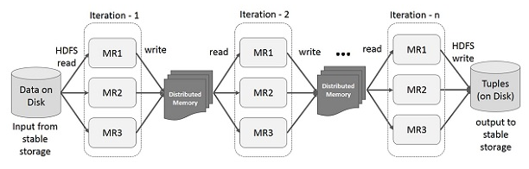
Why Spark?
Most Machine Learning Algorithms are iterative in nature, because each iteration can improve the results.
Disk based approach is slower, because each iteration’s output will be written into disk.
Spark stores intermediate results in a distributed memory instead of Stable storage (Disk) and make the system faster. If the Distributed memory (RAM) is not sufficient to store intermediate results (State of the JOB), then it will store those results on the disk.

Slide 7
Introduction
The main feature of Spark is its in-memory cluster computing.
Spark uses Hadoop in two ways – one is storage and second is processing.
There are three ways of Spark deployment
Standalone: Spark occupies the place on top of Yarn and space is allocated from HDFS, explicitly. Here, Spark and MapReduce will run side by side to cover all spark jobs on cluster.
Hadoop Yarn: Hadoop Yarn deployment means, simply, spark runs on Yarn without any pre-installation or root access required. It helps to integrate Spark into Hadoop ecosystem or Hadoop stack. It allows other components to run on top of stack.
Spark in MapReduce (SIMR): Spark in MapReduce is used to launch spark job in addition to standalone deployment. With SIMR, user can start Spark and uses its shell without any administrative access.

Slide 8
Introduction contd..
Spark follows lazy evolution to process data.
There are two type of operations:
Transformation, are functions that take a RDD as the input and produce one or many RDDs as the output. These are lazy operations on a RDD. E.g. map , filter , reduceByKey , join , cogroup , randomSplit, etc.
Action, are RDD operations that produce non-RDD values. They materialize a value in a Spark program. In other words, actions are RDD operation that returns a value of any type. E.g. reduce, saveAsTextFile, saveAsNewAPIHadoopDataset, etc.

Slide 9
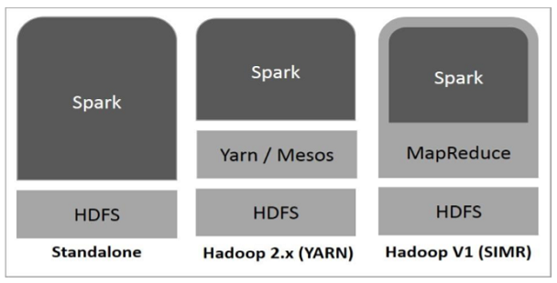
Hadoop Stack with Spark

Slide 10
Spark Stack
Spark SQL
For SQL and Unstructured data processing
Spark Streaming
Stream processing of live data stream
Mlib
Machine Learning algorithms
GraphX
Graph processing
Spark SQL
Spark Streaming
MLlib (machine learning)
GraphX (graph)
Apache Spark

Slide 11
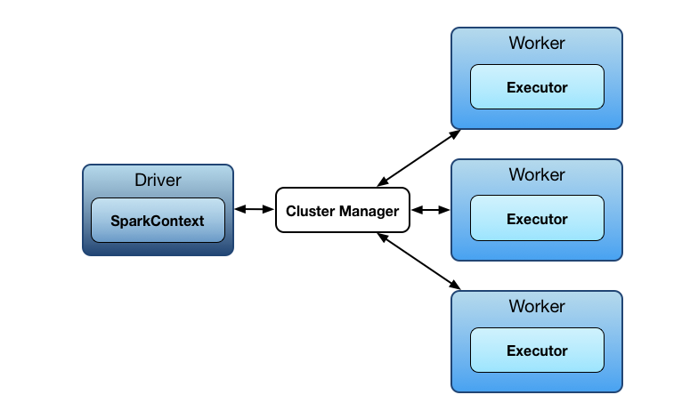
Execution Flow

Slide 12
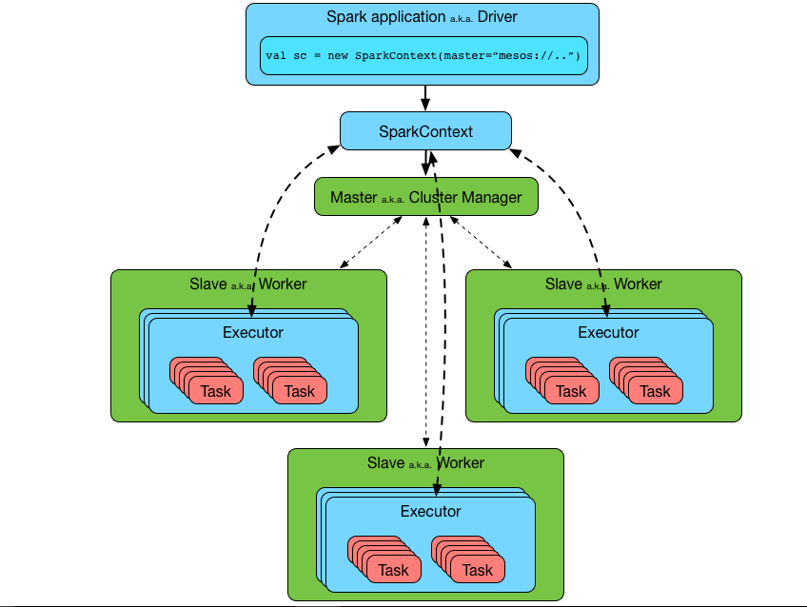
Execution Flow in detail

Slide 13
Terminology
Application Jar: User program and its dependencies except Hadoop & Spark Jars bundled into a Jar file.
Driver Program: The process to start the execution (main() method)
Cluster Manager: An external service to manage resources on the cluster (standalone manager, YARN and Apache Mesos)
Deploy Mode
Cluster: Driver inside the cluster
Client: Driver outside of cluster
Worker node: Node that run the application program in the cluster
Executor
Process launched on a worker node, that run the tasks
Keep data in-memory or disk storage
Task: A unit of work that will be sent to executor

Slide 14
Terminology contd..
Job
Consist multiple tasks
Created based on a action
Stage: Each job is divided into smaller set of tasks called stages that is sequential and depends on each other
Spark Context: Represents connection to a spark cluster, and can be used to create RDDs, accumulators and broadcast variables on that cluster.

Slide 15
Resilient Distributed Datasets (RDDs)
The key idea of spark is Resilient Distributed Datasets (RDD); it supports in-memory processing computation. This means, it stores the state of memory as an object across the jobs and the object is sharable between those jobs.
RDD is a basic abstraction in Spark
Immutable, Partitioned collection of elements that can be operated in parallel
Characteristics:
A list of partitions
A function for computing each split
A list of dependencies on other RDDs
Partitioner for key-value RDDs
A list of preferred locations to compute each split

Slide 16
RDD contd..
There are two ways to create RDDs
Parallelizing an existing collection.
Referencing a dataset in an external storage system
RDDs maintain lineage information that can be used to reconstruct lost partitions
HDFS File
Filtered RDD
Mapped RDD
filter (func = _.contains(...))
map (func = _.split(...))

Slide 17
Logistic Regression Performance
127 s / iteration
first iteration 174 s
further iterations 6 s

Slide 18
Behavior with not enough RAM

Slide 19
Fault Recovery Result

Slide 20
Spark Applications
In-memory data mining on Hive data (Conviva)
Predictive analytics (Quantifind)
City traffic prediction (Mobile Millennium)
Twitter spam classification (Monarch)
Collaborative filtering via matrix factorization

Slide 21
END of Day1

